Slide 1
Alice’s Adventures in Wonderland & The Diary of Anne Frank
Workshop: Tuesday, September 11th, 2018

Slide 2
Germany’s Story: Pre - WWII
The Rise of Nazi Germany
poverty/unemployment at an all-time high
most people dissatisfied with their government
Formed in 1920: German National Socialist Labor Party – Adolf Hitler
German people: superior race—stronger, more intelligent, and better
Potential beautiful future
To Blame? Jews: degenerate race that was evil, dishonest, and dangerous
By 1933:
Largest party in Germany—Hitler becomes head of government
All parties except Nazis were banned & democracy in Germany ceased to exist
Hitler took control of daily life

Slide 3
Hitler’s Persecution
The Persecution of the Jewish Culture & The Frank Family
Hitler launched campaign of anti-Semitism on radio, in newspapers, in films, etc.
1933: Frank family leaves Germany and moves to Amsterdam
Hitler prepares for war:
1938-1939: Hitler invades Austria, parts of Czechoslovakia, and Poland
1939: England/France declare war
May 10, 1940: Hitler invades the Netherlands
At first, life remained relatively the same
Soon Jews…
Must wear a yellow start, hand in their bicycles
Are banned from trams, are forbidden to use any car
Are only allowed to shop at certain times, in certain shops
Must be indoors from 8:00 in the evening until 6:00 in the morning

Slide 4
The Need for Hiding:
By 1942:
Anne had received her diary (Kitty)
Otto Frank had transferred ownership of his company
Family planning for hiding
July – Margot received call-up notice from Secret Service
Family moves into hiding
The Play
Diary vs. Play
Imagined experience of 8 people who lived in the Secret Annex
Based on Anne’s Diary (Kesselmen version)
Powerful moments for each member of the cast

Slide 5
Characters:
Unique Acting Experience:
12 Angry Jurors vs. Diary of Anne Frank
Real people—historical figures
Complexity
Who they are before / in public
How they respond to circumstance
Play—two years
Every actor:
RICH: Growth/evolution of character
Powerful moments
Character work (so much to learn!)

Slide 6
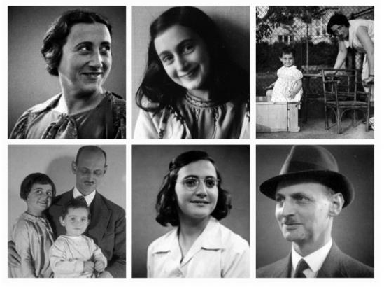
Characters: Frank Family
Otto:
A wonderful man: supportive—helps people work together
Slight German accent
Edith:
Nervous, strained—struggles with Anne, Van Daans, situation
Slight German accent
Margot:
Polite and well behaved
The ideal child (mature)
Anne:
Must grow significantly throughout the play
Must be able to demonstrate great versatility (rambunctious –insightful, playful – despair)

Slide 7
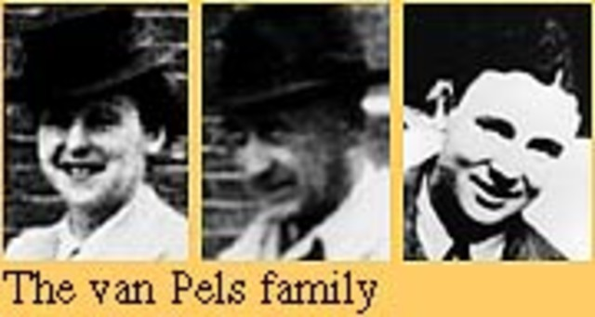
Characters: The Van Daan Family
Mr. Van Daan:
A strong, successful man
Jovial in the beginning, struggles with circumstances/others as play progresses
Mrs. Van Daan:
Needs great versatility
Flirtatious to loving to spiteful to despairing
Peter Van Daan:
Shy and awkward
Eventually forms a relationship with Anne
Challenging relationship with his father

Slide 8
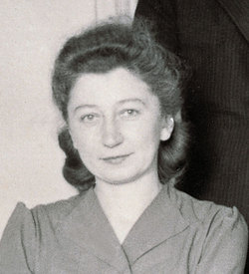
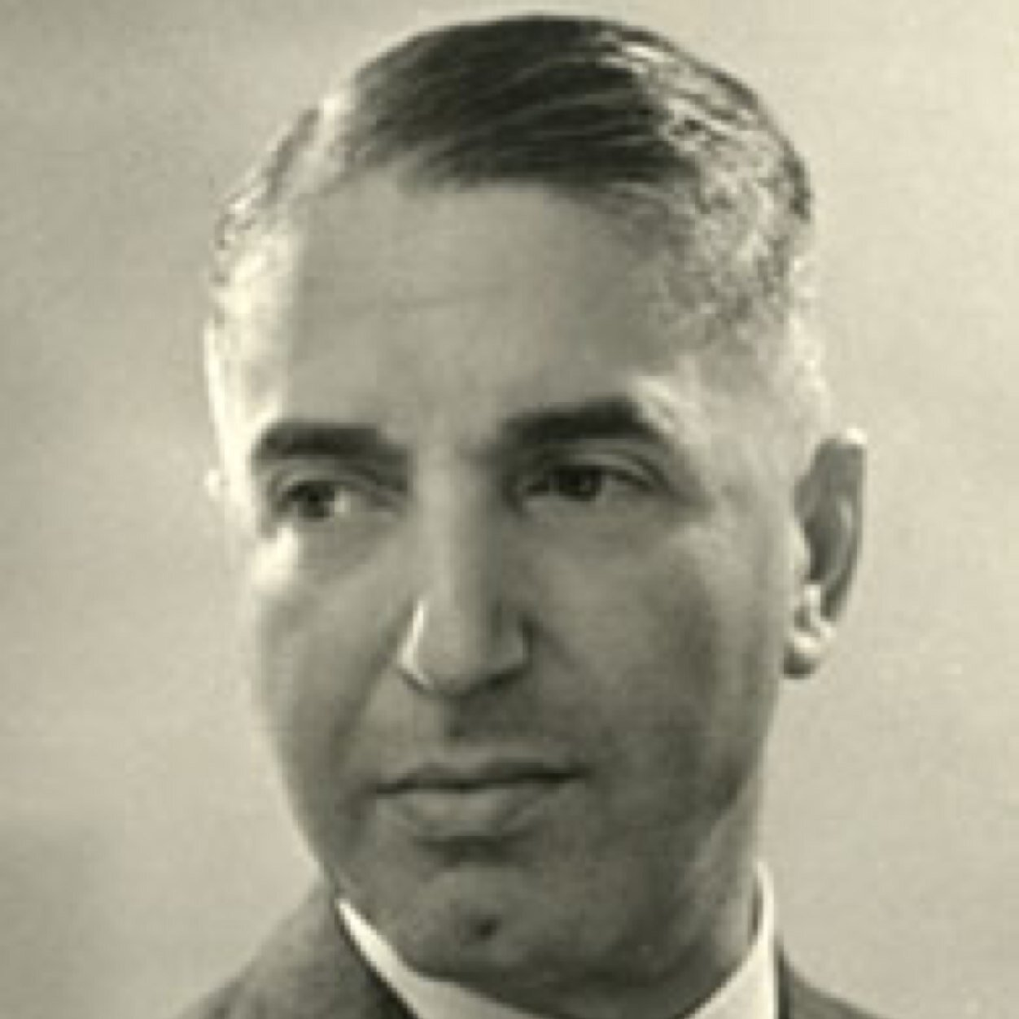
Characters: The Others
Miep Gies & Mr. Kraler:
Two characters crafted from several people who helped the Franks survive in hiding.
Links to the outside world—both providing joy and excitement but also providing information and at times, difficult news
Mr. Dussel:
Last person to move into the Secret Annex
Dentist—Shares a room with Anne
Although he has some bright moments, he is an anxious, rigid man who struggles with the confines of the annex
The Nazis:
Small roles—at the end of show—but horrifically frightening for the audience
Will also make up some of the broadcast voices (the ones where we do not have the original recordings)

Slide 9
AUDITIONING TIPS
Perception: Confident and Likable
BEGINNING OF AUDITION
Posture
Eye Contact
Handing Sheet
Where do I look during a monologue?!?!
END OF AUDITION
Smile & Make Eye Contact
Say THANK YOU
Walk out confidently NO MATTER WHAT

Slide 10
Auditions: Diary Monologues & Scenes
Step One: take out your theater handbook and read the auditioning section—carefully
Step Two: find several characters (2-3) that you would like to audition for (be realistic about your strengths and weaknesses)
Step Three: find the speeches/scenes assigned to the characters you would like to play
Step Four:
If it is a speech on your own—get to work ☺
If it is a scene with one or more people—find (a) partner(s) and get to work ☺
When preparing the monologue/scene, keep in mind ways you can embody that character vocally, physically, and mentally
Step Five: Be confident in the work you’d done and NAIL THOSE AUDITIONS!

Slide 11
Final Reminders:
AUDITIONS:
Wednesday, September 12th OR Thursday, September 13th (beginning at 3:45/3:50 in the Choir Room)
CALL BACKS:
Friday, September 14th(beginning at 3:45/3:50 in the Choir Room)
PERFORMANCE DATES:
Alice: October 20th, 21st
Diary: November 9th, 10th, 16th, 17th
Audition Forms
Hand Out Monologues/Scenes
WFBHSTHEATER.COM/Auditions
Break a Leg—YOU CAN DO THIS!

